Slide 1
Employee Attrition Analysis
IBM HR Attrition Dataset
Presented by
A. Neeha Krishna

Slide 2
Contents
1. Introduction
2. Objectives
3. KPIs Used
4. Data Dictionary
5. Data Cleaning
6. Insights

Slide 3

Introduction
Employee attrition refers to the rate at which employees leave an organization over time.
This project uses data driven insights to understand why employees leave and how organizations can improve retention
Findings support HRs to focus on satisfaction , workforce and engagement of employees

Slide 4

Objectives
Analyze Employee Attrition trends
Identify factors influencing attrition (age, salary, job satisfaction).
Provide insights to improve retention

Slide 5
KPIs Used:
01
02
03
Attrition Rate
Average Monthly Income
Average Tenure
Measures the percentage of employees leaving the organization over a specific period
How salary levels differ by department or role
How long employees typically stay
04
05
Overtime Percentage
Job Satisfaction Index
Find if working overtime increases the chances of leaving
Measures the satisfaction levels of employees

Slide 6
Data Dictionary
Column Name
Description
Data Type
Age
Age of the employee
Numeric
Department
Department of the employee
String
Education
Education level of the employee
String
Daily Rate
Daily Salary Rate
Numeric
Attrition
Attrition Status
Boolean

Slide 7
Data Cleaning / Preprocessing
No missing values found in critical fields
Created derived fields
Age Group,
Salary Band,
Satisfaction Score
Validated data consistency and distribution

Slide 8
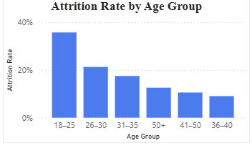
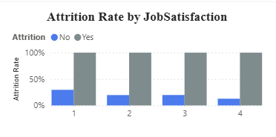
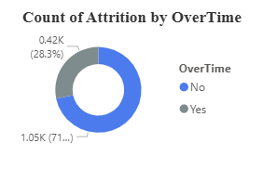



Insights
01
02
03
Explains how age group is affecting the attrition rate.
Satisfaction and attrition are negatively correlated
Explains how overtime impacts attrition

Slide 9
Thank You!!

